Slide 1

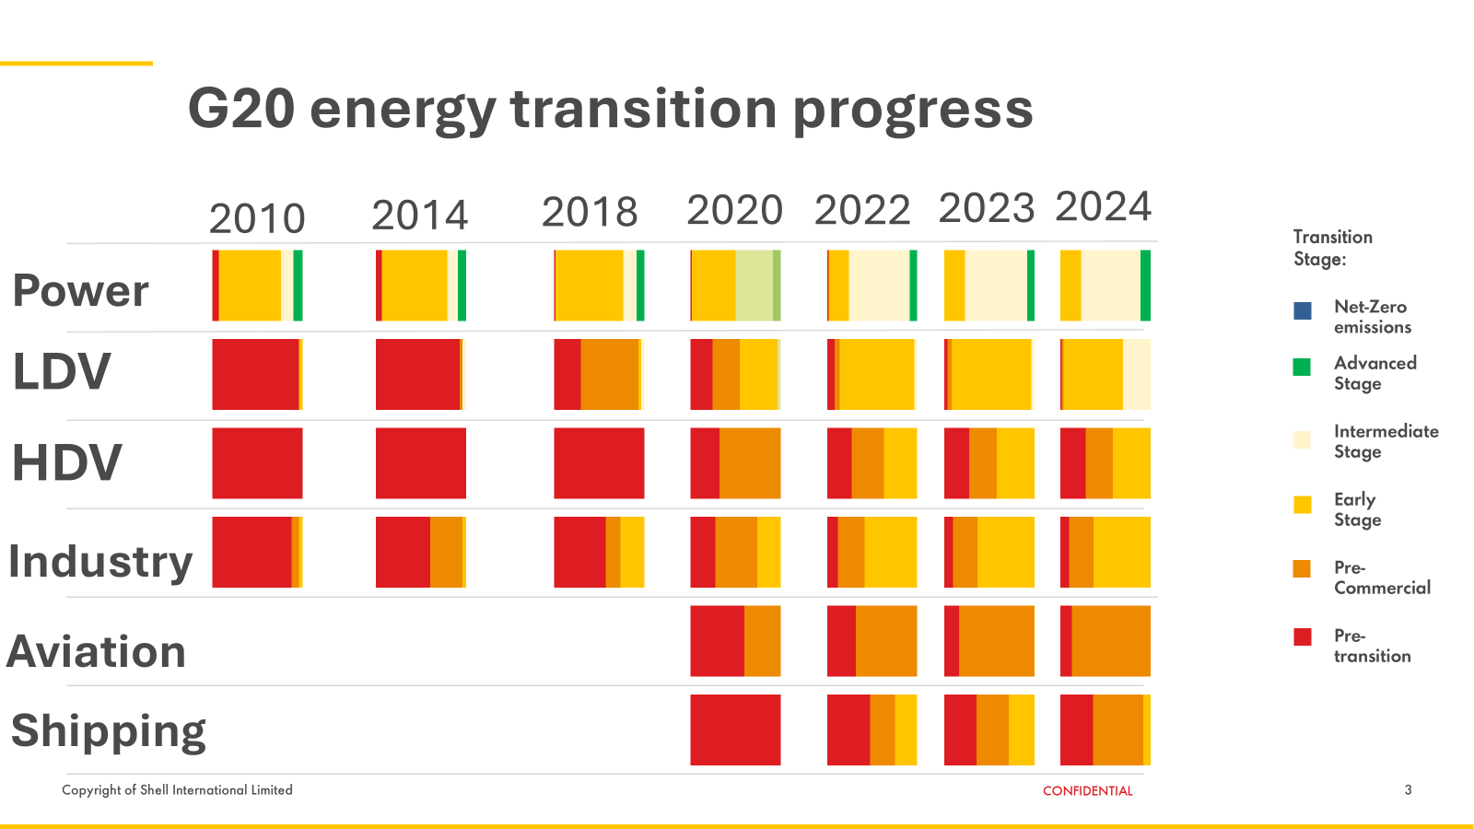
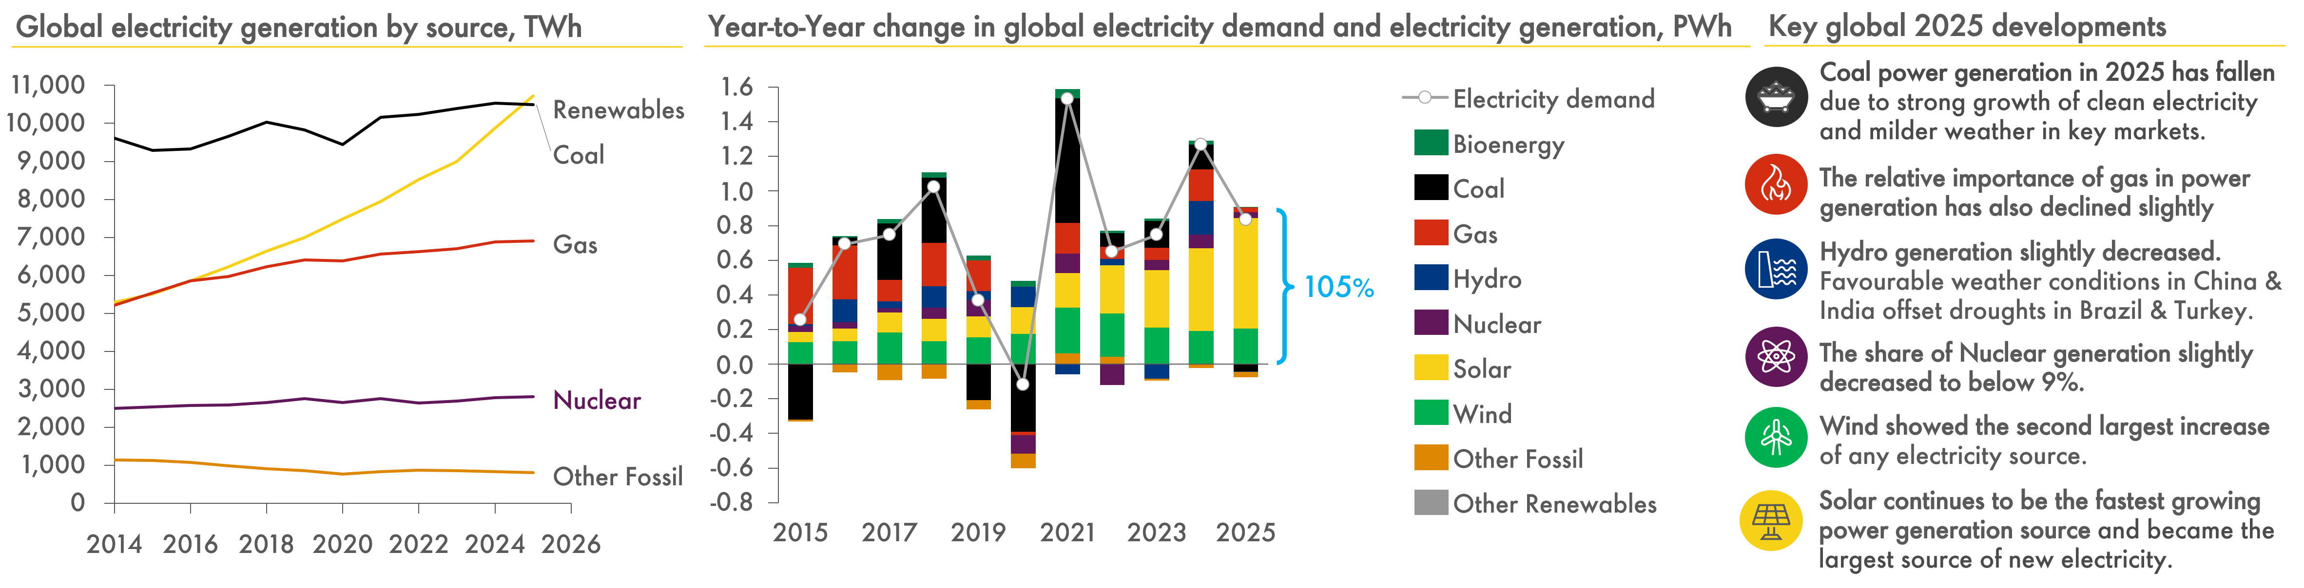
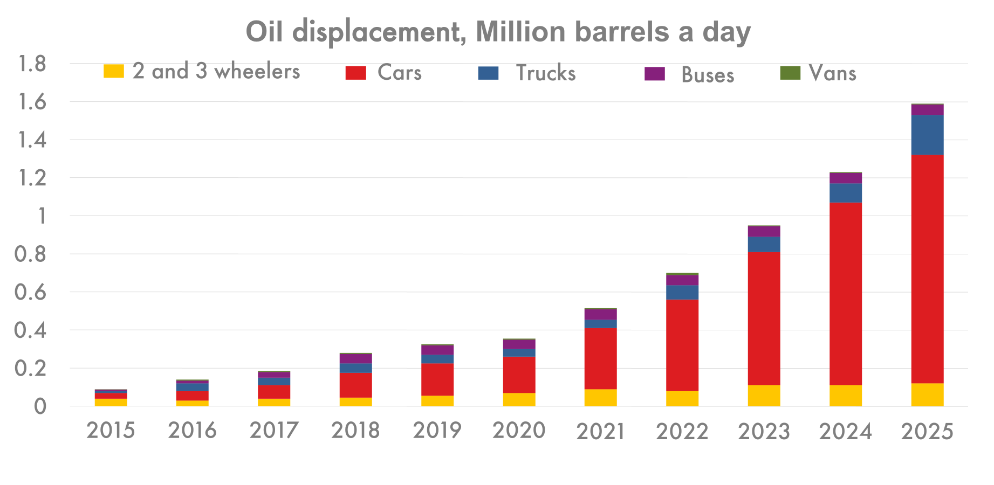
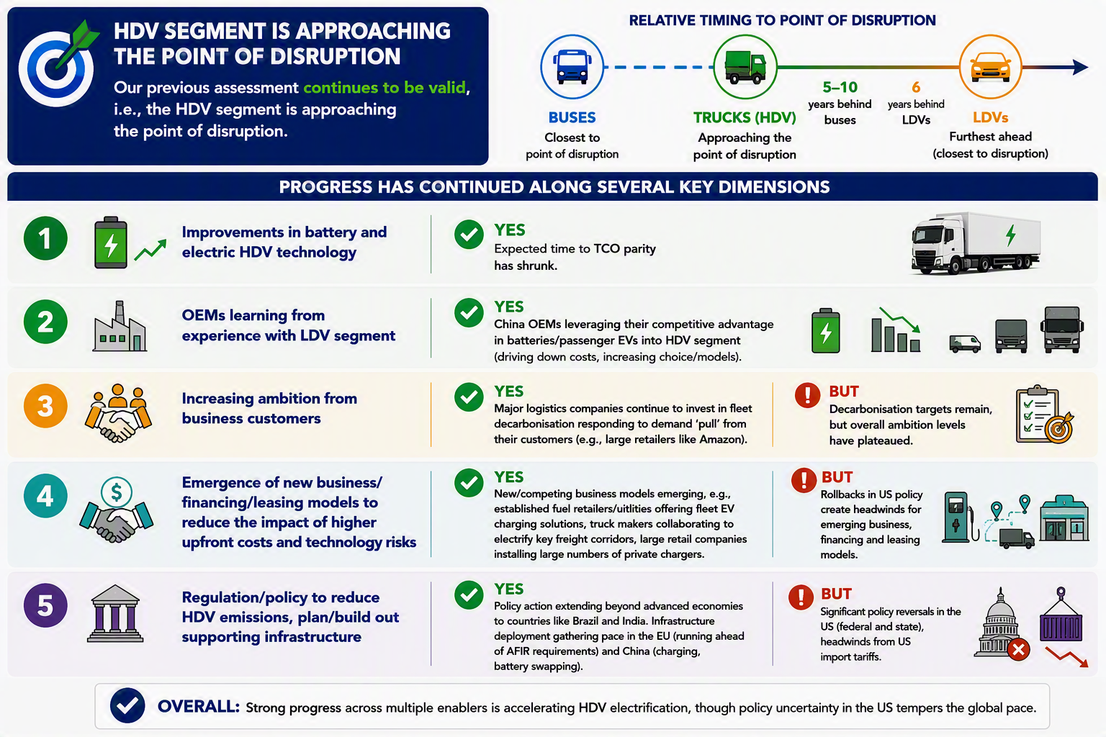
MARKET ENGAGEMENT & EXTERNAL INSIGHTS
GLOBAL PACE OF THE ENERGY TRANSITION
SHAPE
CONNECT
ACCELERATE
A systematic assessment by sector, across the G20 and over time
Mansi Konar, Thomas Telsnig and Sowmya Santhanam
SCA Global Team F2F 2026 | 7–8 September
A consistent framework for tracking transition progress and momentum
Heatmap for G20 energy transition progress
The boxes show the proportion of G20 GDP in each of the 6 transition stages
The Pace heatmap shows that progress slowed in hard-to-abate sectors like heavy industry, aviation and shipping but continues in power and road transport .
Six transition Stages
Pre-transition
Pre-commercial
Early
Intermediate
Advanced
Net-zero
Power sector transformation is disrupting at scale
Oil displacement has been increasing for LDVs
HDVs are approaching the point of disruption
Improvement in battery and electric HDV technology
Chinese OEMs learning from experience with LDV segment
Logistic companies invest in fleet decarbonisation but no strengthening of ambition
Emergence of new business/financing/leasing models
Policy action extending beyond advance countries but US reversals
A trusted source of insight across SCA and Shell
Building in-house expertise
Integrating evidence
Translating insights into action
Shape. Connect. Accelerate.
September 7–8, 2026

